Slide 1
Global economic
crisis and its effects
in India.
Submitted in partial fulfillment of the requirements for the degree of
Masters of Business Administration (MBA)
(Savitribai Phule Pune University)
By
Name of the Student: SHUBHROJYOTI GHOSH
Under the Guidance
of
Prof. Dinesh Malusare
At
Arihant Institute of Business Management
(2018-2020)

Slide 2
Contents
Introduction
Objective of the study
Research Design
Data Interpretation & Findings
Conclusion
Suggestions
Bibliography

Slide 3
Introduction
“The economic crisis” started in summer 2007.
Started off with the subprime mortgage crisis ;
Quickly morphed into a full-fledged crisis of historic proportions. Forced a rethinking of international financial linkages
The global ramifications of this crisis were largely unforeseen.

Slide 4
First impact : bankruptcy of Lehmann Brothers in September 2008.
The present study focuses on origin of the global economic crisis and the impact on Indian economy.
Commentators drawn parallels with the Great Depression(Ended with WWII) of the 1930’s.
The global crisis has affected India through three distinct channels: financial markets, trade flows, and exchange rates.

Slide 5
Objective of the study
To define the causes of the crisis (financial integration, capital flows and global imbalances)
To explain the spread of the crisis (contagion through banks, investors, and other channels)
To define the policies to reduce country vulnerability in the future(reserve accumulation, capital controls, prudential policies, and changes to the global financial architecture).

Slide 6
Research Design
The research design is the conceptual structure within which research is conducted.
This research was descriptive in nature.
The data for the study has been collected from secondary sources.
The tools that are used to present the data are
tables and graphs.
Lack of sources of primary data due to the presence of COVID-19 and a nation wide lockdown.

Slide 7
Data Interpretation & Findings
Causes:
Sub-prime mortgage
The crisis originated from sub-prime mortgage in USA in 2007.
US Banks went out of their way to lend to sub-prime borrowers who had no collateral assets.
This lead to the increment of real estate prices and ownership in US. 50 million owners were sub prime burrowers out of a total of 75 million.
But, the housing bubble burst in 2007. Home prices fell between 20 per cent and 35 per cent.
Consequently, sub-prime borrowers started defaulting in large numbers. The banks had to report huge losses.

Slide 8
Securitization and Repackaging of Loans:
These sub-prime mortgages were securitized and re-packaged by bankers/lenders, and were sold and resold as rated products of profitable investments.
. In 1980 only 10 per cent of US mortgages were securitized compared to 56 per cent in 2006.
The booming housing sector brought to the fore a system of repackaging of loans.
Excessive Leverage:
Global economic outlook (2008) reported that the final problem came from excessive leverage.
The US (1975) leverage limit was 12 times . However, in 2004, the banks were allowed to keep more than double leverage on their balance sheets. That sends financial prices even lower.
The institutions which were highly leveraged, reported huge losses.

Slide 9
All this led to massive bailout packages in USA.
The role of leverage and credit is, central to growth. Yet, excessive leverage is fraught with dangerous consequences.
Mismatch between Financial Innovation and Regulation:
Striking a balance between freedom and restraint is imperative.
Fair value accounting rules
This ensured that what began initially as a sub-prime crisis morphed into a general credit deterioration touching prime mortgages and causing their credit downgrades and system -wide mark downs.
Failure of Global Corporate Governance
Many of America's big banks moved out of the "lending" business and into the "moving business“.

Slide 10
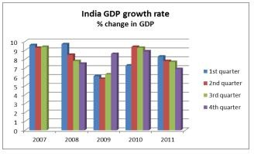
Impact on Indian Economy : Though initially somewhat insulated (consumption and saving were well-balanced), eventually was impacted significantly by the global shocks through trade, finance and exchange channels.
Impact on Indian GDP growth rate: Economic growth is the increase in value of the goods and services produced by an economy. The impact of the crisis in India, has been observed in the slowing down in the growth rate of the economy, between August 2008 and March 2009, by about four percent .

Slide 11
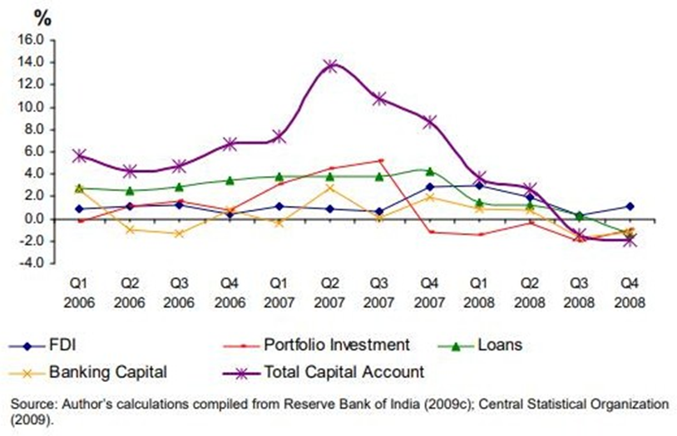
Impact on Inflation rate: By January 2010, the domestic growth signals were pointing towards a consolidation of the recovery process. However, Inflation in primary commodities moved up 8.2 in August 2009 to 22.2 per cent by March 2010.
Impact on Indian FDI inflows:The presence of FDI inflow in India has been steady post-liberalisation . The sluggishness of the inflows of FDI, ECBs, and remittances combined with the massive outflow of FII has resulted in the significant deterioration of India’s capital account in FY2008–2009.
Impact on Export and Import: In 2009-10 export and import of India reached in negative. Consequently,demand for Indian product has reduced.

Slide 12
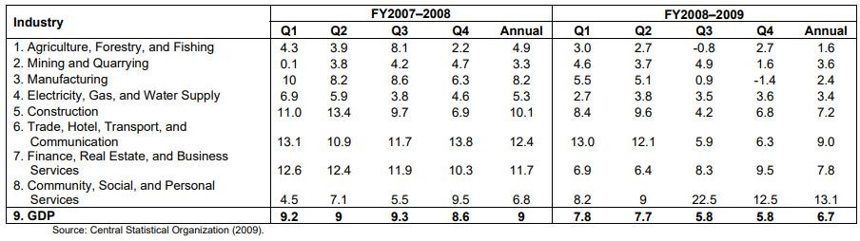
The Overview of affected sectors in the Indian economy.
Gems and jewellery sector Got effected by “Double Squeeze”. It is highly integrated with the global market.
Auto parts and engineering industries also lost export a significant proportion of their output and have a well-developed domestic market.
Textiles and garment Industry is largely in the unorganized sector, responsible for 20 percent of the total export earnings .The export demand for garments started falling in the later half of 2008 and continued to decline thereafter.
Chikan craft industries having low average income , having export a significant part of their output, plunged in recession

Slide 13
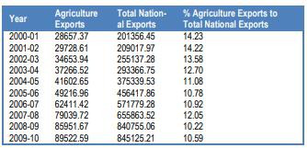
Impact on Indian Agriculture: India has opened its market July 1991 by lowering tariff and non tariff barriers, as well as liberalizing investment policies. Still is far less vulnerable to the external economic shocks than agriculture in many developing countries. However,it cannot be completely insulated from the global and domestic economic recessions. It is difficult to gauge the impact of economic crisis on Indian agriculture in the short run. However, the trends in some broad parameters may indicate its implications and the possible options can be worked out to mitigate its adverse impact.

Slide 14
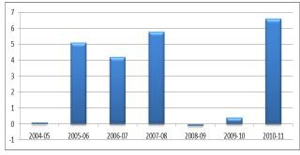
Agricultural Exports remarkable developments have taken place in India’s agricultural exports during the post-liberalisation period. one, the agricultural exports have grown at a much faster rate since the initiation of liberal economic policies where agricultural exports in value terms have grown annually from 18.9 per cent during 1990s to 15.2 per cent during 2000s but after 2000 it reduced gradually. However, the decline or slowdown in exports cannot be entirely attributed to the economic recession.
Agricultural GDP: The trend in
agricultural GDP during the past two
decades suggests that the sector
has been growing slowly and steadily,
but with occasional slumps. Agricultural
GDP is declined by -0.1 per cent in
2008-09 as compared to 5.8 per cent in 2007-08. The trends in Ag.GDP seem to have weak links with the present recession (Fig). It is important to note that rainfall and other weather parameters influence agricultural growth significantly.

Slide 15

Impacts on Fisheries :
Economic Crisis in Fisheries: The Asian Economic Crisis gives negative impacts to fisheries and any fisheries-related business. In domestic fish markets, demand for fisheries products is on sharp decline. Export of Indian fisheries products mainly for Asian markets is in a severe slump. Before the Crisis, exporters were prevented from further expansion of trading products with lower additional value. In a much contrast, domestic-oriented production remained in depression.
Impact on Fisheries Export:However, the decline or slowdown in exports cannot be entirely attributed to the economic recession. Quantity exported in the year of 2006-07 was 612 thousand tonnes and it has been reduced in the year 2007-08 to 541 thousand tonnes. However, Collectors have to reduce their scale of transaction and reduce purchase prices of Indian fishes/ shrimp. This causes damage to small-scale fishers who are engaged in catching fry and young fish.

Slide 16
Conclusion
While the developed world, including the U.S, the Euro Zone and Japan, has plunged into recession, the Indian Economy is being affected by the spill-over effects of the global financial crisis, interacted with other crises, notably those of food and fuel prices, in complex ways.
Great savings habit among people, strong fundamentals, strong conservative and regulatory regime have saved Indian economy from going out of gear. Although significant parts of the economy have slowed down and there is a wide variance of opinion about how long it will continue.
It is expected that growth will be moderate in India. Though World Trade Organization (WTO) propagates free trade, we must adopt protectionist measures in certain sectors of the economy so that recession in any part of the globe does not affect our country.

Slide 17
Suggestions
Plan for crises before they occur. Governments need both to invest in prevention (e.g. via adequate regulation of finance) and to stress-test their economic policy.
Support local-level coping mechanisms. The state should recognize this in its approach to crises. Monitor the impact and talk to people.
Learn lessons and replenish resilience. Each crisis is different, and provides different lessons to the nation. But each crisis also depletes the coping capacities, both physical and psychological. After the crisis has passed, there is an urgent and particular need to top-up these sources to deal with the next large shock before it arrives.

Slide 18
Bibliography
Websites:
http://mitsloan.mit.edu/shared/ods/documents/?DocumentID=4933
https://www.undp.org/content/dam/india/docs/exe_sum_final.pdf
http://www.economicsdiscussion.net/term-paper/economic-crisis-term-paper/term- paper-on-global-economic-crisis-economics/30506
https://unctad.org/en/docs/gds20091_en.pdf https://www.researchgate.net/publication/255668975_The_Global_Economic_Crisi s_and_Developing_Countries_Impact_and_Response
https://www.adb.org/sites/default/files/publication/156019/adbi-wp164.pdf

Slide 19
THANK YOU

